Slide 1
CS 129.18 CSCI 214

Slide 2
Some Stuff About Me
I’m Hadrian Paulo Lim
Just call me Hadrian
Background
Data Scientist, Manulife – Advanced Analytics for Canada (2019 - )
Data Scientist, General IT guy, EpiMetrics, Inc. (2015 – 2018)
Education
MS CS (2016-2018)
BS Computer Engineering (2011-2016)

Slide 3
CS 129.18
Linear Regression

Slide 4
Linear Regression
𝐲 = 𝐗𝜷 + ε

Slide 6
A function 𝐲 = x𝜷 + ε
X → data
β → coefficients
ϵ → error in data
y → target

Slide 7
T
y₀
y₁
𝐲 =
→
y_{n}
𝐲 is the target variable vector

Slide 8
T
x₀
x₁
x =
→
x_{n}
𝐗 is a vector of features you want to predict with

Slide 9
T
𝜷₀
𝜷₁
𝜷 =
→
𝜷_{n}
𝜷 is the coefficient vector

Slide 10
T
ε₀
ε₁
ε =
→
ε_{n}
ε is the error term or noise vector

Slide 11
Linear regression is basically y = mx +b
Let’s make it more interesting

Slide 12
Multivariate Linear Regression
𝐲 = 𝐗𝜷 + ε

Slide 13
Linear method for modelling the relationship between a dependent or target variable, and one or more or independent variables.

Slide 14
A function 𝐲 = 𝐗𝜷 + ε
X → data
β → coefficients
ϵ → error in data
y → target

Slide 15
T
y₀
y₁
𝐲 =
→
y_{n}
𝐲 is the target variable vector

Slide 16
x_{0,0} x_{0,1} x_{0,2} ... x_{0,n}
→
x_{1,0} x_{1,1} x_{1,2} ... x_{1,n}
𝐗 =
→
→
→
x_{n,0} x_{n,1} x_{n,2} ... x_{n,n}
→
𝐗 are the features or values you want to predict against

Slide 17
T
𝜷₀
𝜷₁
𝜷 =
→
𝜷_{n}
𝜷 is the coefficient vector

Slide 18
T
ε₀
ε₁
ε =
→
ε_{n}
ε is the error term or noise vector

Slide 19
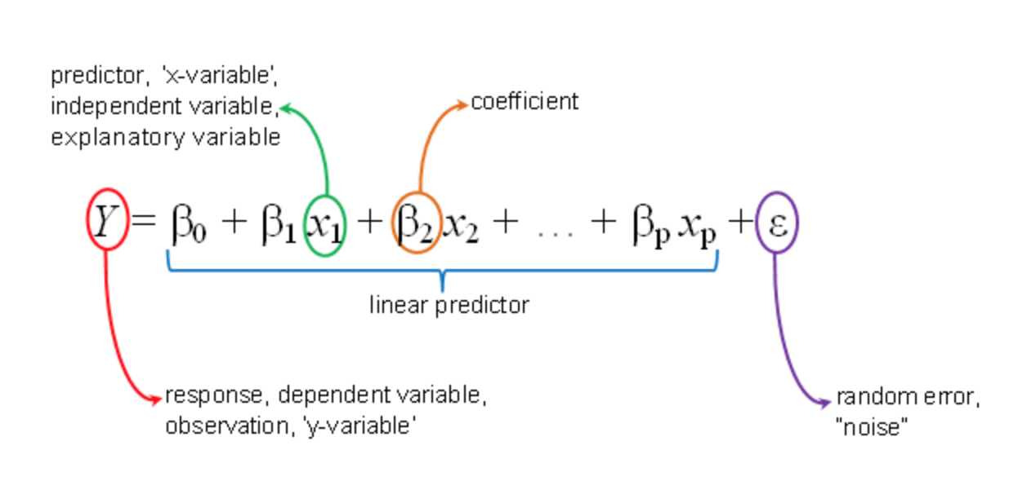

Slide 20
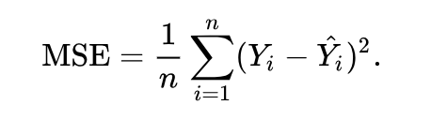
Mean Squared Error
The MSE is a measure of the quality of an estimator—it is always non-negative, and values closer to zero are better.

Slide 21
But what does that all mean?

Slide 23
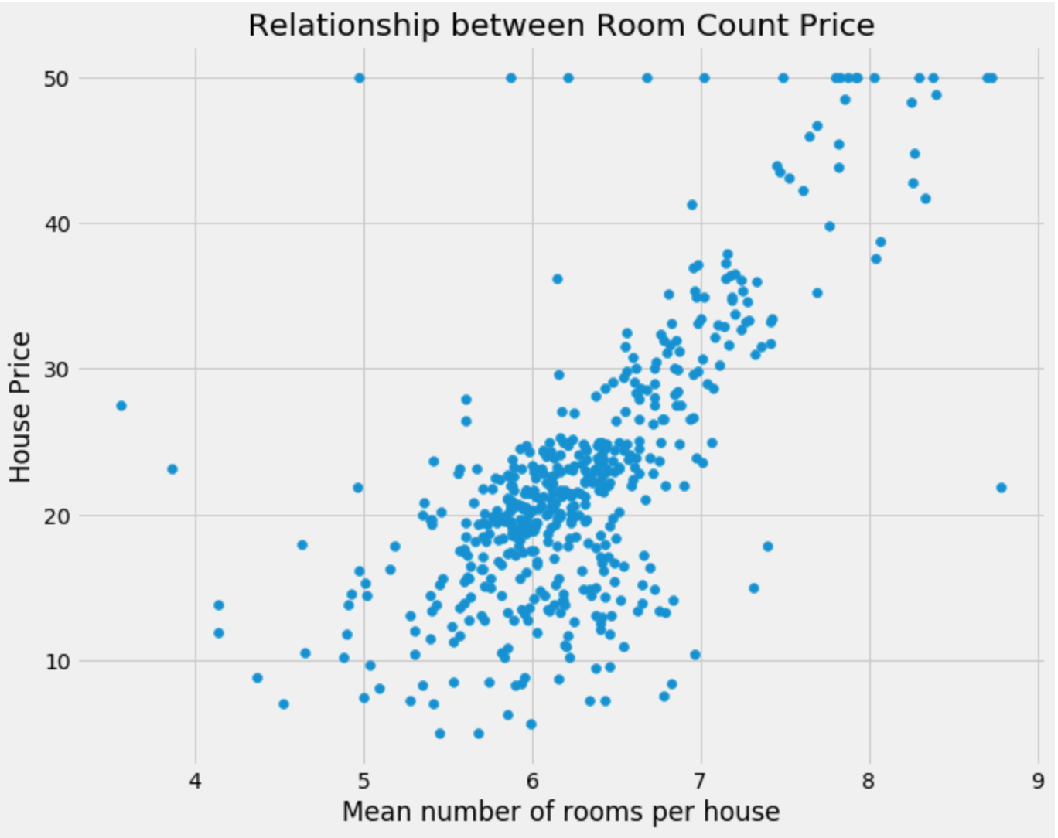

Slide 25
You get to predict new values based off existing data

Slide 26
Thank you

